Slide 1
Point Cloud Rendering
Christopher Jeffers, Eric Jensen, Joel Rausch
May13-11

Slide 2
Purpose
Siemens PLM creates software to view and compare 3D models.
Some tools, such as 3D laser scanners, output these models as a large group of points in (x,y,z) space.
This collection of points is known as a "point cloud".
Siemens PLM desires a product that can render very large point clouds (100s of millions to a billion points).
May13-11

Slide 3
Problem
Computer hardware is very good at drawing sets of triangles (meshes), not optimized for single points.
Difficult and very demanding on hardware to draw every point, especially for very large (a billion point) point clouds.
  Possible Solution: Use approximations of points to reduce number of points to be drawn.
May13-11

Slide 4
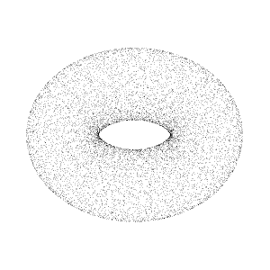
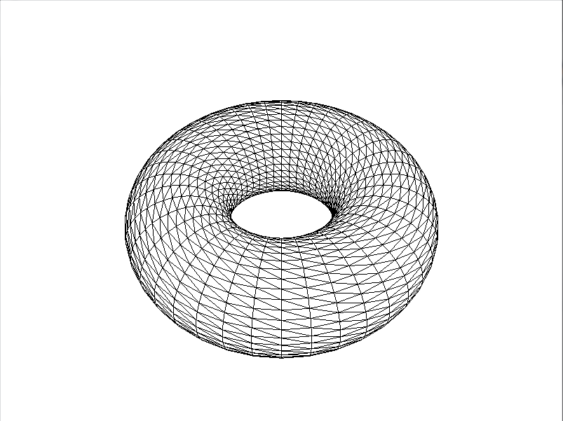
Point Cloud vs. Mesh
Point Cloud
Mesh
May13-11

Slide 5
Solution
Our research led us to a system created at Stanford University in the year 2000, called QSplat.
QSplat uses a very efficient and compressed tree structure to organize point cloud data.
Traversing this tree allows us to find where a point should be rendered.
Adapting QSplat to current technology allows us to reach our goal of rendering a billion points.
May13-11

Slide 6
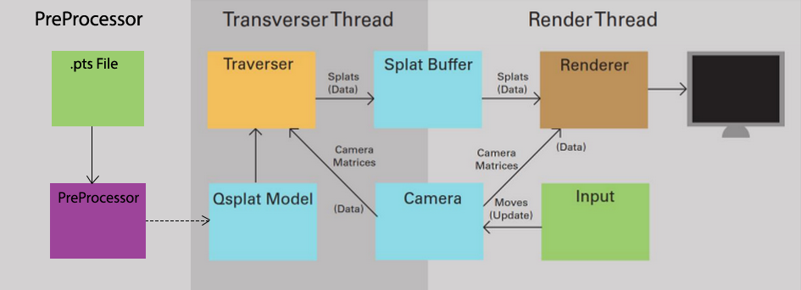
Program Structure
We perform two major tasks on separate, dedicated threads of execution. Traversal puts the points to render in a buffer, and the Renderer reads from this buffer and draws the points to the screen.
May13-11

Slide 7
Traversal
Choosing which points to render
Discarding points that are not visible
  Points not visible to the camera (frustum)
  Points which are behind other points (occluded)
  Points which are too small (sub-pixel size)
Performance is affected by how points are organized.
May13-11

Slide 8
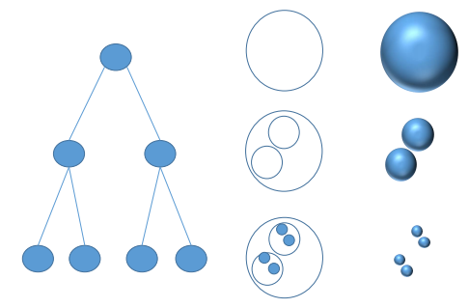
QSplat Tree Structure
Points are leaves in the tree.
Clusters of points are bounded by spheres, which form branches.
May13-11

Slide 9
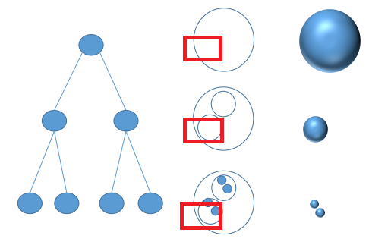
Traversing the QSplat Tree
Drawing branches approximates a cluster of points.
Prune entire tree branches.
Prioritize closer branches.
May13-11

Slide 10
Rendering
Take the points currently in the buffer and render them to screen at an interactive frame rate.
May13-11

Slide 11
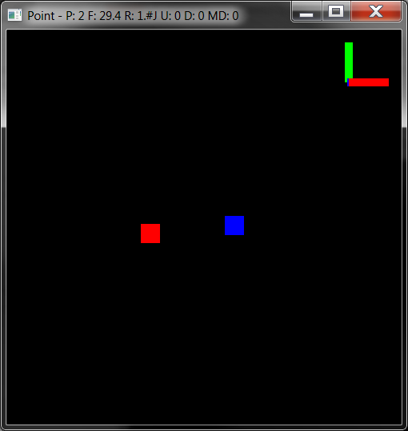
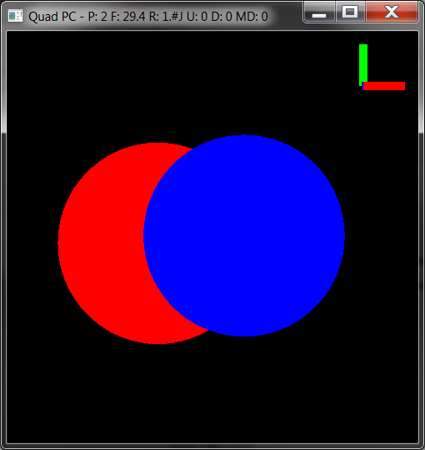
What is a Splat?
Points
Splats
May13-11

Slide 12
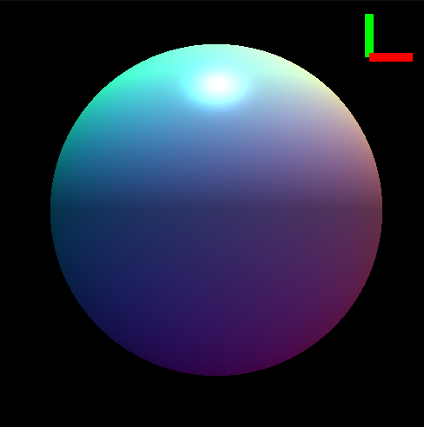
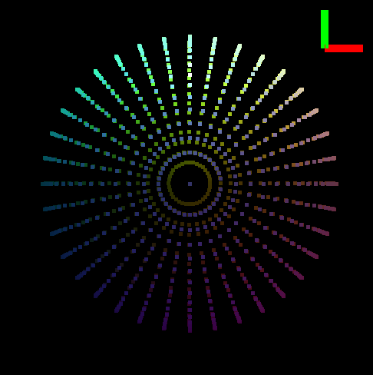
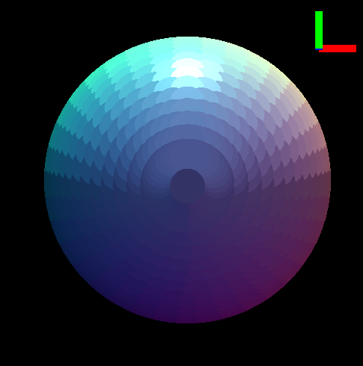
Why Use Splats?
Convert a point back to a surface.
Real
Object
Sampled
Points
Approximated Surface
May13-11

Slide 13
Drawing a Splat – Step 0
Global State:
  Virtual Camera
Begin with:
  Point
  Normal Vector
  Radius
  Color
May13-11

Slide 14
Drawing a Splat – Step 1
  Using the normal vector, we find two vector at right angles to each other and the normal vector
May13-11

Slide 15
Drawing a Splat – Step 2
  Using the coordinate system to create a the splat with the given radius and color
May13-11

Slide 16
Drawing a Splat – Step 3
  The splat relative to the model’s coordinate system
May13-11

Slide 17
Drawing a Splat – Step 4
  Transform the splat to be relative to the camera’s coordinate system
May13-11

Slide 18
Drawing a Splat – Step 5
  Transform the splat to be relative to the screen’s coordinate system
May13-11

Slide 19

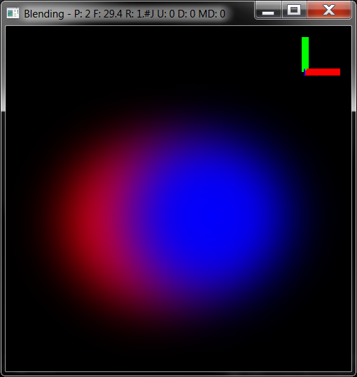
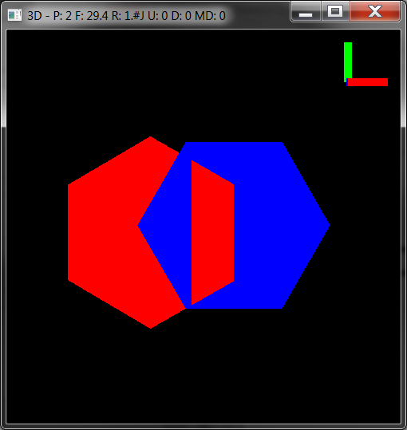
Types of Splats
OpenGL Points
Circle (Quad)
Blending
3D Depth Correct
Billboard
Blending
May13-11

Slide 20
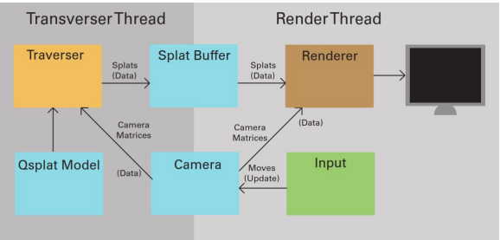
Program Structure
May13-11

Slide 21
QSplat Tree Structure
May13-11

Slide 22
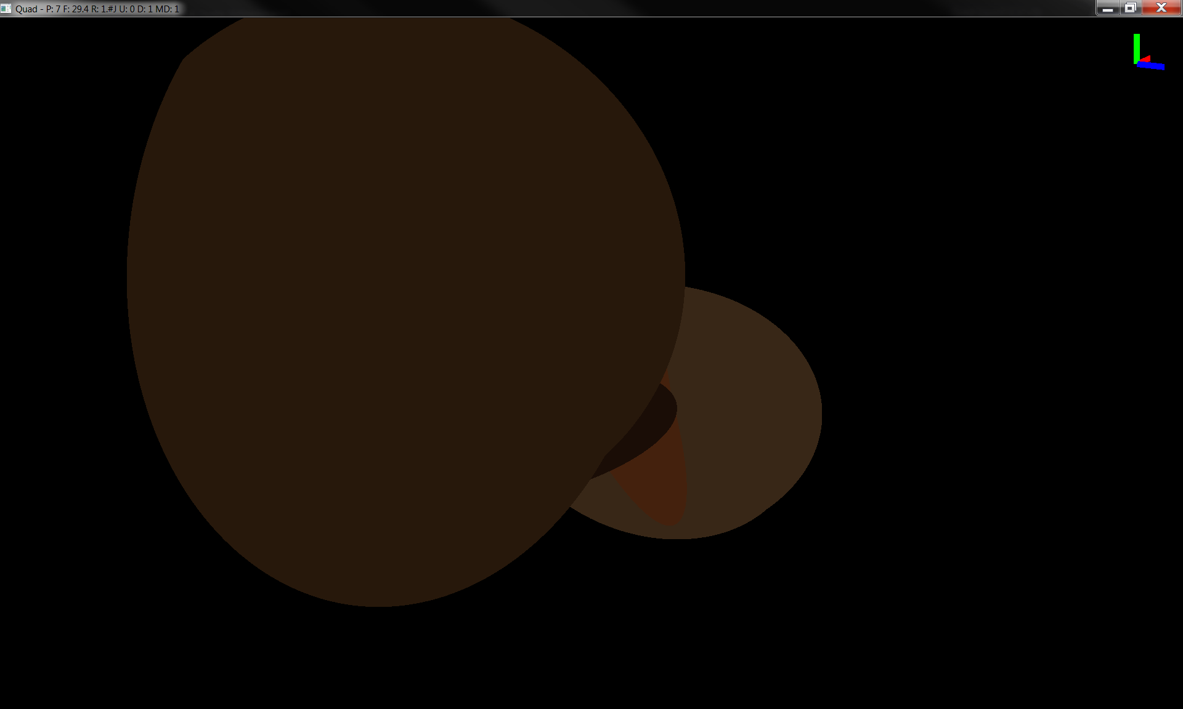
Depth 0

Slide 23
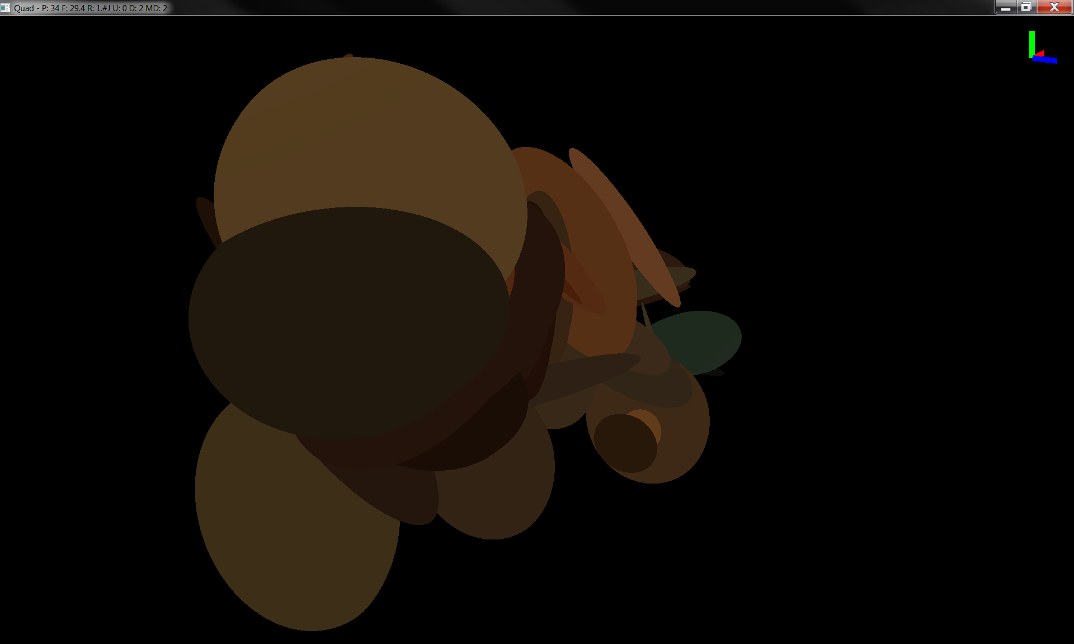
Depth 1

Slide 24
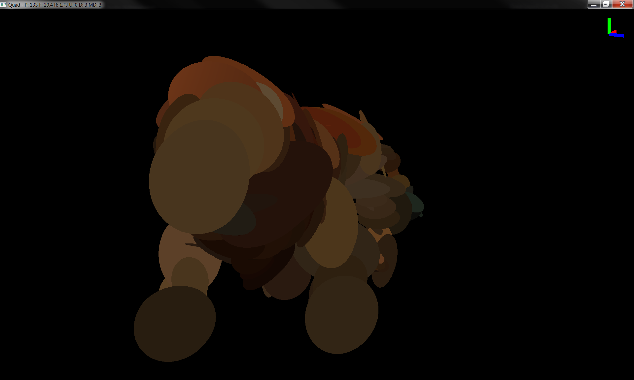
Depth 2

Slide 25
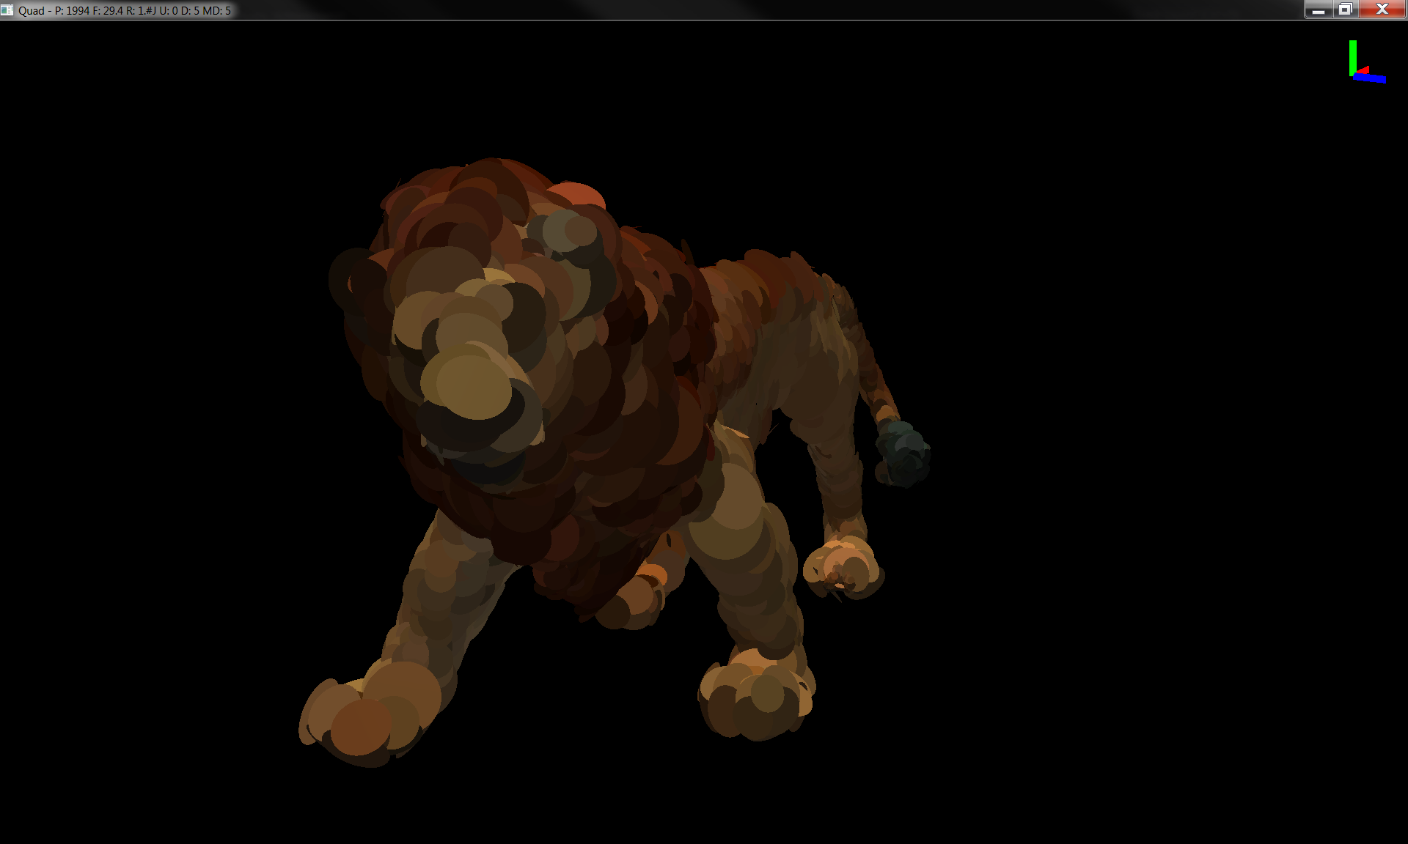
Depth 4

Slide 26
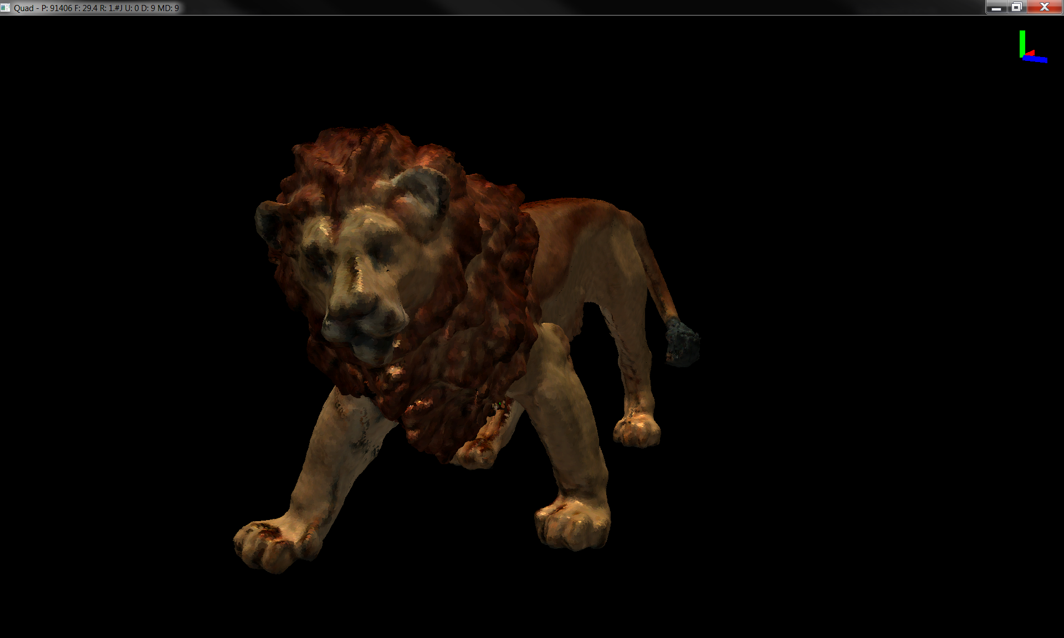
Depth 8

Slide 27

Depth Max

Slide 28
Moving Results

Slide 29
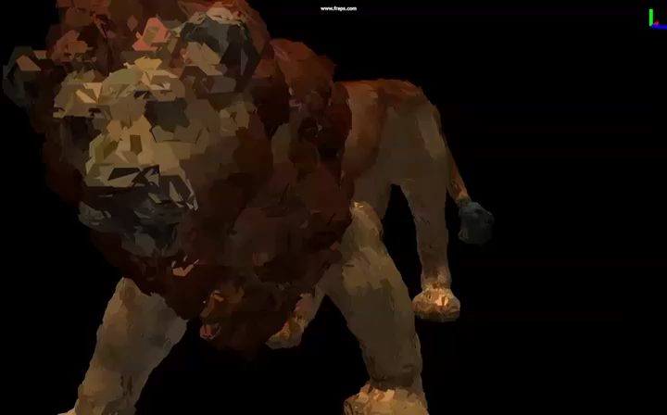
Depth Correct

Slide 30
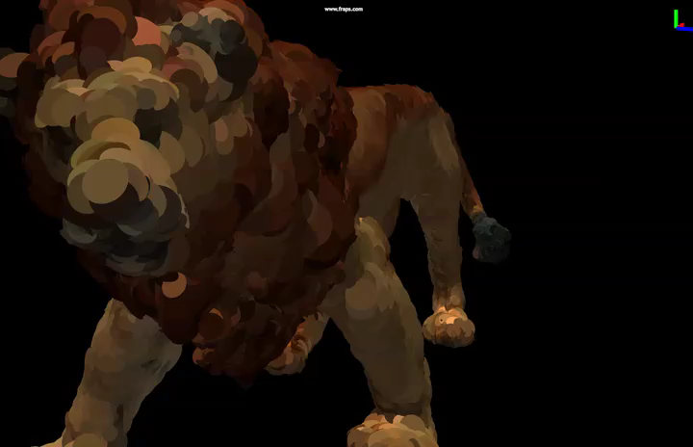
Billboard Quad

Slide 31
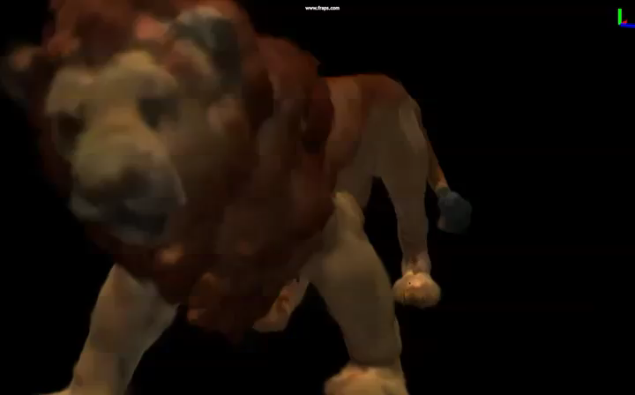
Blended Hexagon

Slide 32
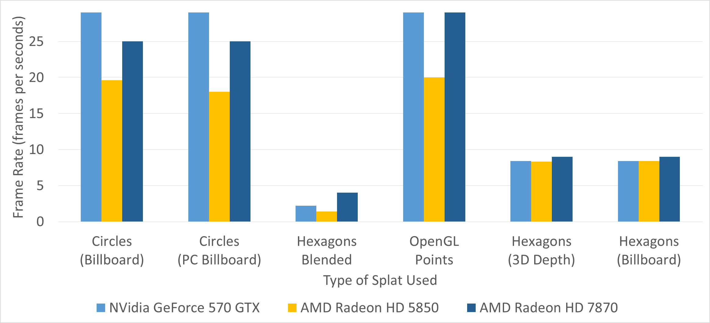
Frame Rate Comparison
May13-11

Slide 33
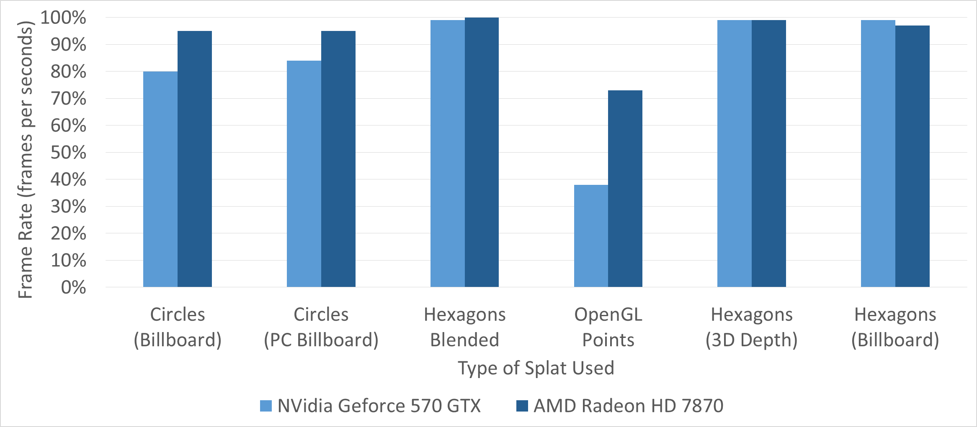
GPU Usage Comparison
May13-11

Slide 34
Responsibilities
Member | Implementation | Research
Chris | Preprocessor | Octree
Eric | Rendering System | Ray Casting
Joel | Traversal | QSplat
May13-11
Notes:
Traversal: Version 1 - DFS, Version 2 - Mine Multi-threaded BFS (Iter 1 - no occlusion, Iter 2 - occlusion)
Buffer: Version 1 - DFS, Version 2 - Single Max-heap, Version 3 - Double variant Max-heap

Slide 35
Challenges
Working with 13 year-old code
  Problems
    Uses more complex methods to do simple things because of hardware limitations that no longer exist.
    Uses some functionality that have been replaced.
    Incompatible number format.
  Solutions
    Wrapped their interface to fix inconsistency in data.
May13-11

Slide 36
Challenges
Working with a billion points
  Problem
    Large model files
  Solution
    Compress the file to a tree-based hierarchy, then use memory mapping and a top-down traversal to minimize thrashing.
May13-11

Slide 37
Challenges
Designing rendering system to work on varying hardware.
  Problem
    Not all hardware supports OpenGL functionality.
    Supported Platform:
      NVidia Quadro
      NVidia Geforce
      AMD Radeon
      Intel Integrated GPUs
  Solutions
    Check compatibility of hardware.
    Limit features used from newer OpenGL versions.
May13-11

Slide 38
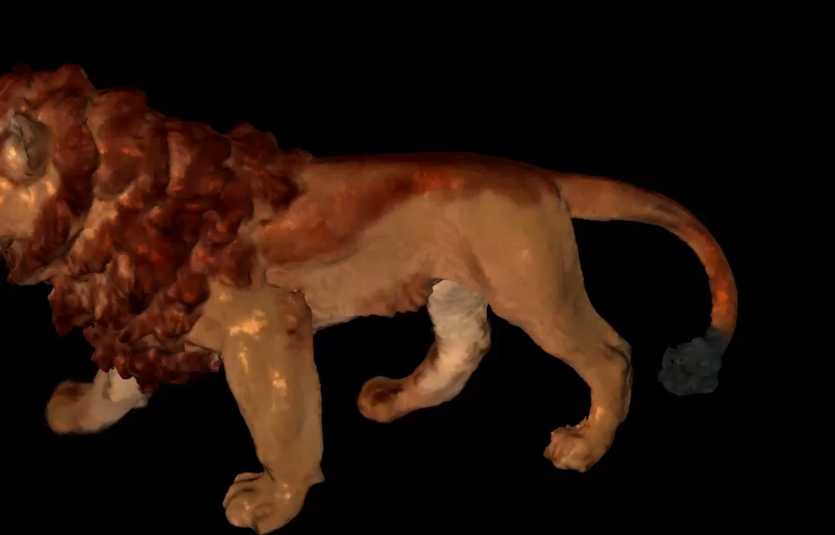
Questions?

